Slide 1
Hadoop

Slide 2
Cloudera Installation
System Requirements
Hardware Requirements: (A) Quad Core Processor (VT-x or AMD-V support recommended), 64-bit; (B) 8 GB RAM; (C) 20 GB disk free.
Follow the steps given in following link to enable virtual technology in your system
https://techsupportwhale.com/not-in-a-hypervisor-partition/
If your system is not virtual enable then you will get error while importing cloudera in virtual box

Slide 3
Installation
1. Install VirtualBox. Go to https://www.virtualbox.org/wiki/Downloads to download and install VirtualBox for your computer.
For Windows, select the link "VirtualBox 6.x. for Windows hosts x86/amd64" where 'X' is the latest version.

Slide 4
Step 2
2. Download the Cloudera VM. Download the Cloudera VM fromhttps://downloads.cloudera.com/demo_vm/virtualbox/cloudera-quickstart-vm-5.4.2-0-virtualbox.zip. The VM is over 4GB, so will take some time to download.

Slide 5
3. Unzip the Cloudera VM:
Right-click cloudera-quickstart-vm-5.4.2-0-virtualbox.zip and select “Extract All…”
4. Start VirtualBox.

Slide 6
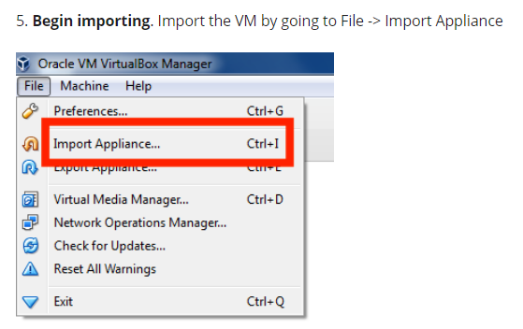

Slide 7

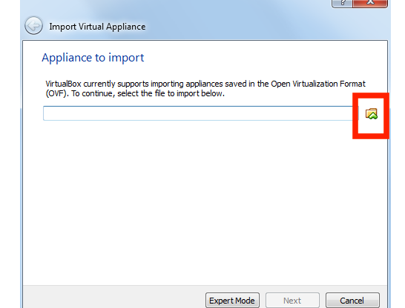

Slide 8
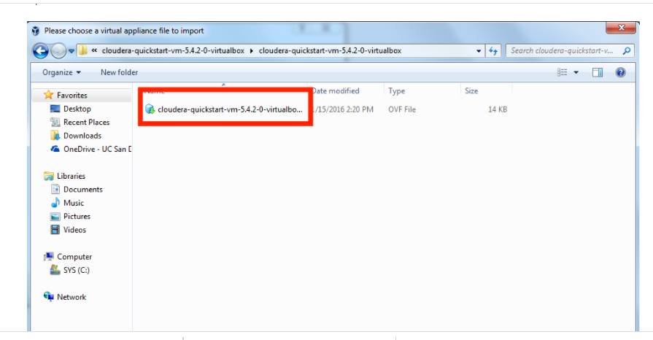
7. Select the cloudera-quickstart-vm-5.4.2-0-virtualbox.ovf from the Folder where you unzipped the VirtualBox VM and click Open.

Slide 9
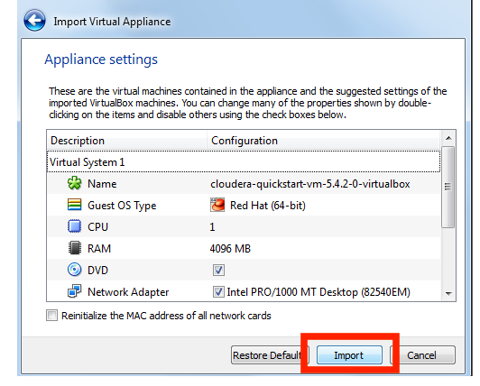
8. Click Next to proceed.
9. Click Import.

Slide 10
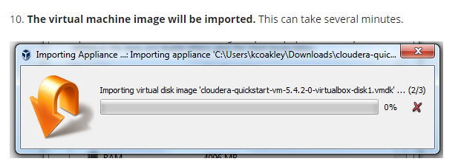

Slide 11
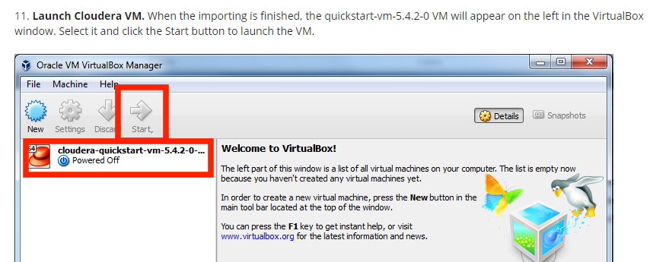

Slide 12
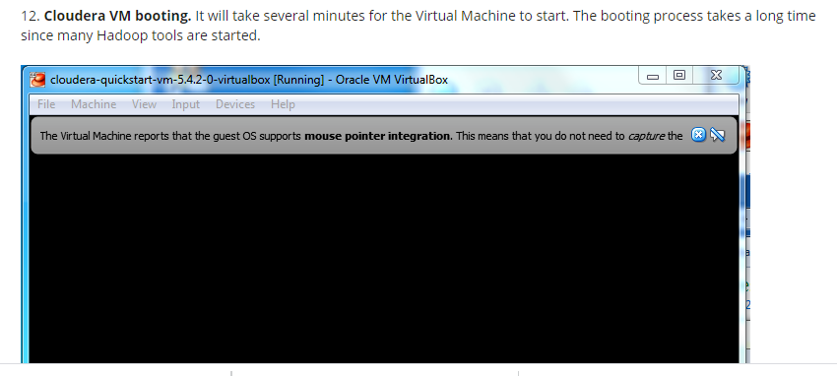

Slide 13
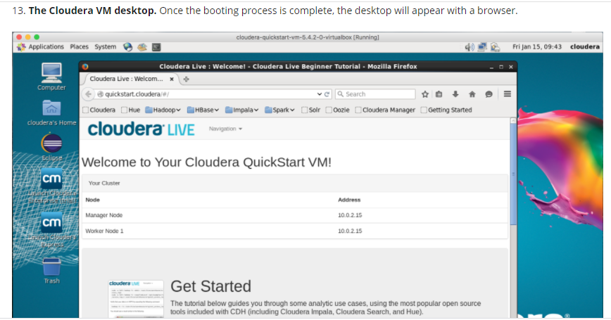

Slide 14
Hadoop Map-Reduce
Hadoop MapReduce is a software framework for easily writing applications which process vast amounts of data (multi-terabyte data-sets) in-parallel on large clusters (thousands of nodes) of commodity hardware in a reliable, fault-tolerant manner.
A MapReduce job usually splits the input data-set into independent chunks which are processed by the map tasks in a completely parallel manner. The framework sorts the outputs of the maps, which are then input to the reduce tasks. Typically both the input and the output of the job are stored in a file-system. The framework takes care of scheduling tasks, monitoring them and re-executes the failed tasks.

Slide 15
Hadoop Map-Reduce
The MapReduce framework consists of a single master ResourceManager, one worker NodeManager per cluster-node, and MRAppMaster per application .
Minimally, applications specify the input/output locations and supply map and reduce functions via implementations of appropriate interfaces and/or abstract-classes. These, and other job parameters, comprise the job configuration.
The Hadoop job client then submits the job (jar/executable etc.) and configuration to the ResourceManager which then assumes the responsibility of distributing the software/configuration to the workers, scheduling tasks and monitoring them, providing status and diagnostic information to the job-client.

Slide 16
Inputs and Outputs
The MapReduce framework operates exclusively on <key, value> pairs, that is, the framework views the input to the job as a set of <key, value> pairs and produces a set of <key, value> pairs as the output of the job, conceivably of different types.
Input and Output types of a MapReduce job:
(input) <k1, v1> -> map -> <k2, v2> -> combine -> <k2, v2> -> reduce -> <k3, v3> (output)

Slide 17
WordCount Application
WordCount is a simple application that counts the number of occurrences of each word in a given input set.

Slide 18
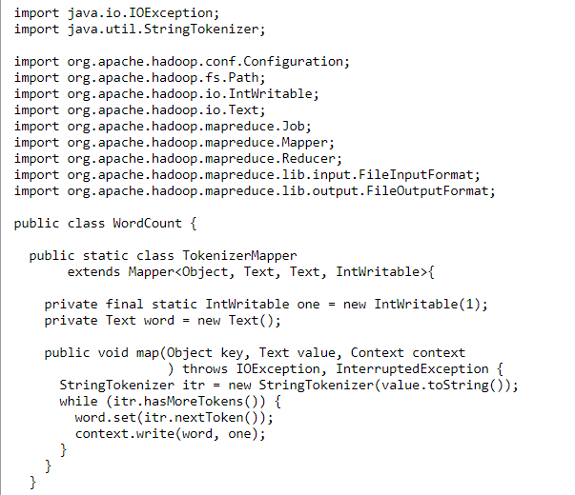

Slide 19
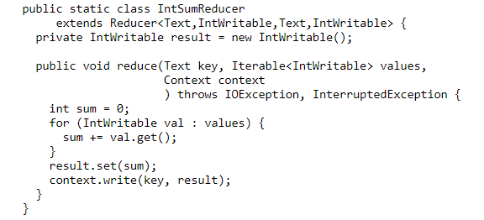

Slide 20
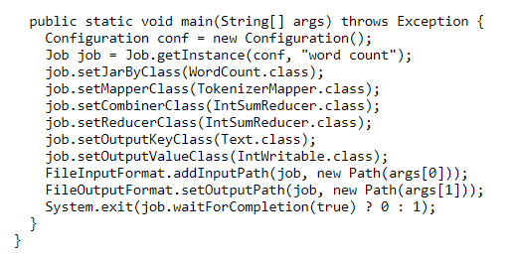

Slide 21
Running WordCount Program on Cloudera
1. Open Virtual Box and start cloudera
2. Open Eclipse on cloudera desktop
3. Creating a Java project
File->New->Java Project->Next
(WordCount is the name of the project)
4. Click on the tab libraries for adding the hadoop librariers to the project
Click on Add external jars then File System->usr->lib->hadoop
Select all the .jar files and add
Again Click on Add external jars then File System->usr->lib->client
Select all the .jar files and click on “oK” and click “finish”

Slide 22
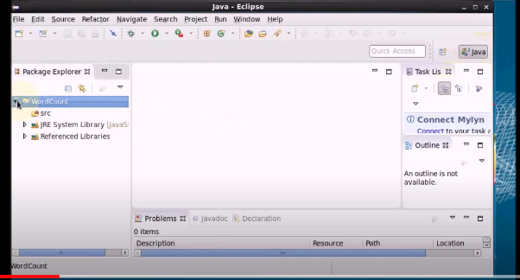
Right Click on src folder of WordCount Project Then File->new->class
In Name write word “WordCount” and click Finish. This is done for creating Java mapper reducer prorgram

Slide 23
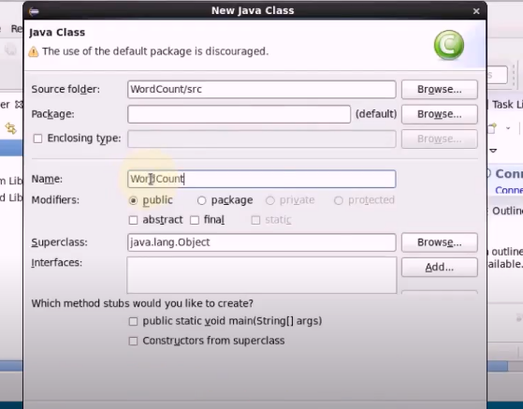

Slide 24
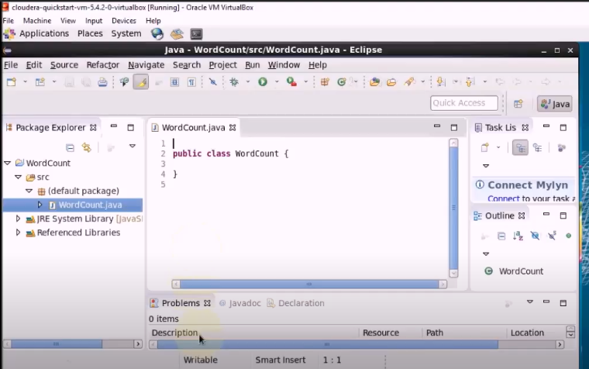
Type the code mentioned in previous slides

Slide 25
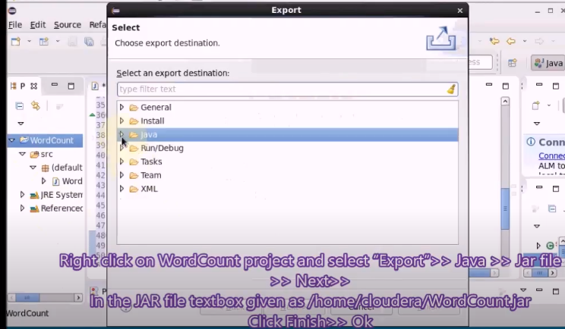
Step 6 : Export the Project as .jar file
Click on “Browse” and type name “wordcount”

Slide 26
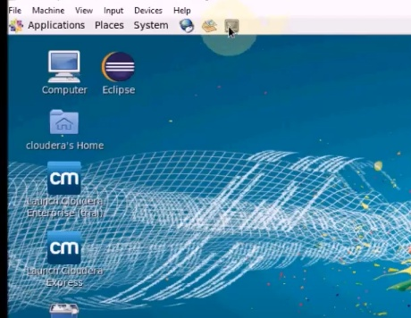
Check .jar file. Go to Computer on desktop. File system->home>cloudera-> wordcount.jar
Verify the .jar file via terminal

Slide 27
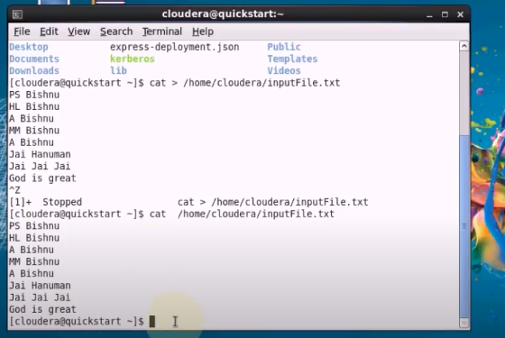
Creating and verifying Input file

Slide 28
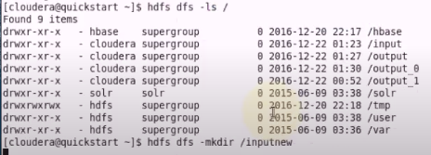
Moving Input file to Hadoop Systtem
Using ls with above command allow us to look into the file system.
For moving file create a directory

Slide 29
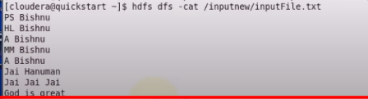
Move the file from Linux system to Hadoop system

Slide 30
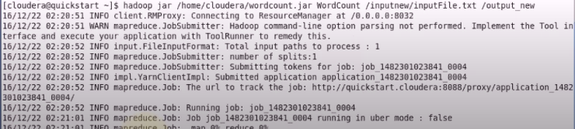
Running Map Reduce Program
Hdoop jar jarFileName.jar ClassName inputFile.txt outputFolderName
Each time create a new output file for running

Slide 31
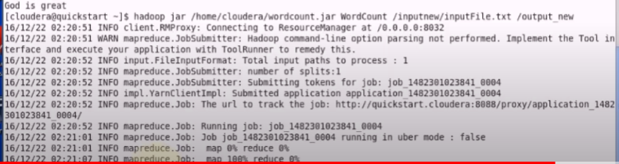
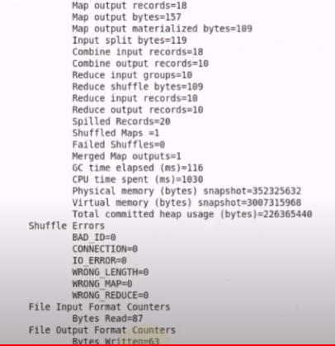

Slide 32
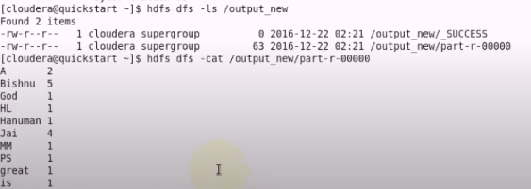
For Viewing Output

Slide 33
References
https://hadoop.apache.org/docs/current/hadoop-mapreduce-client/hadoop-mapreduce-client-core/MapReduceTutorial.html
https://www.youtube.com/watch?v=kF-63_2e1Kk
https://www.coursera.org/learn/big-data-introduction
https://www.michael-noll.com/tutorials/writing-an-hadoop-mapreduce-program-in-python/
https://www.edureka.co/blog/hadoop-streaming-mapreduce-program/

